Slide 1
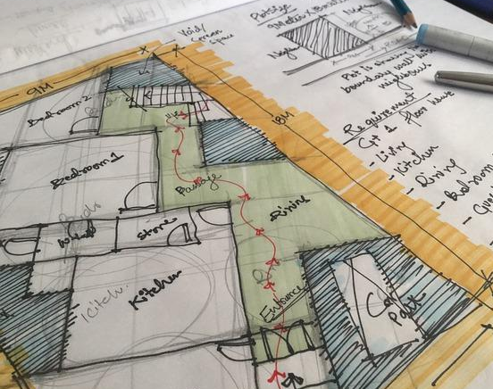
Electrical Service Design of a 9 – Storied Residential Building with Single- and Double-unit Floorplans
A presentation by
1706038 – Asif Billah
1706052 – Nazmus Salehin
1706053 – Saleh Ahmed Khan
1706054 – Tiasa Mondal
1706058 – Abdullah Jubair Bin Iqbal
1706059 – Tasnim Farhan Fatin
1706064 – Sadat Tahmeed Azad
Course: EEE 414
Electrical Service Design

Slide 2
Our Project
Our designed building plan has been taken from an under construction building in Baridhara residential area, with swimming pool facility on rooftop. We had to make proper adjustments to the initial plan to accommodate 9 residential stories, 6 of which are dual units and 3 single units, and had to add another basement parking area to make room for 15 cars (one for each unit) along with the necessary driving ramp for cars to move between levels. We also had to extend the plan to include substation and emergency generator room. Electric designs were then made according to the theory taught in our EEE 414 course and using practical considerations.

Slide 3
Design Steps
Layout
Fittings and features
Conduit
Circuit diagrams
Power Distribution & substation

Slide 4
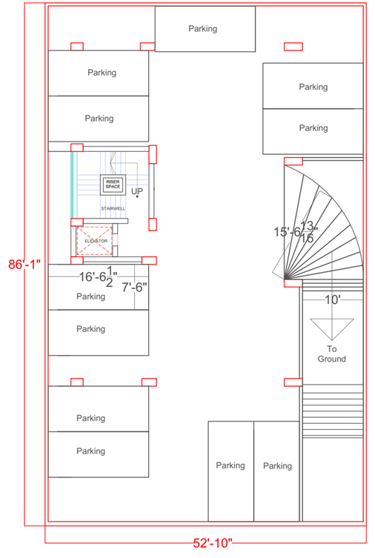
Floor Layout Basement

Slide 5
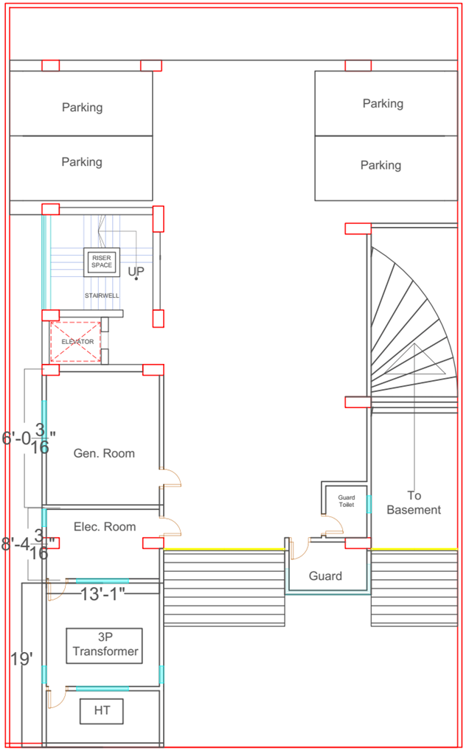
Floor Layout Ground Floor

Slide 6
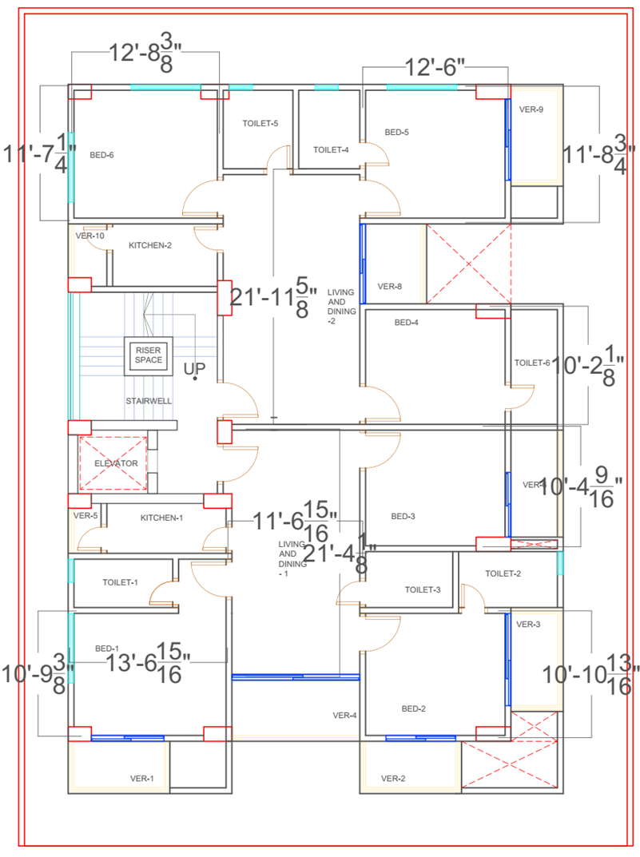
Floor Layout Typical 2 Unit

Slide 7
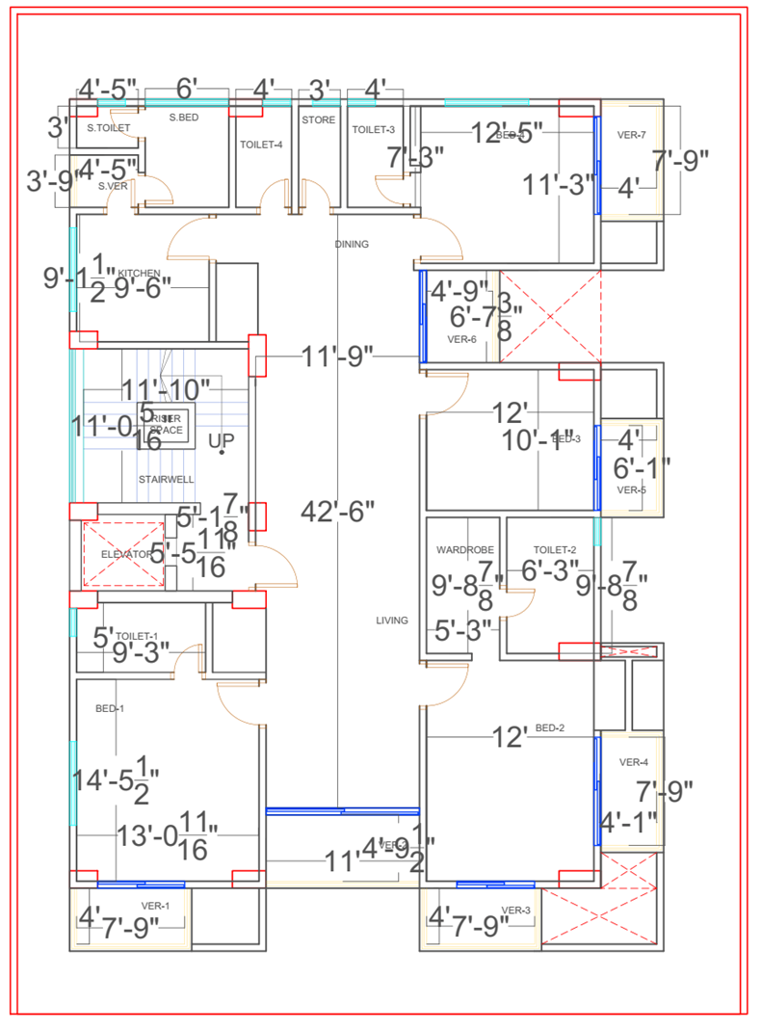
Floor Layout Typical 1 Unit

Slide 8
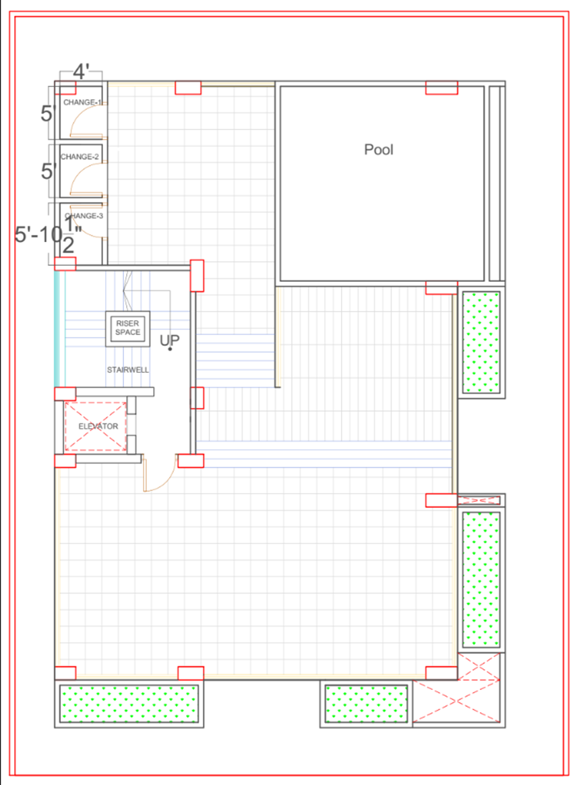
Floor Layout Roof

Slide 9
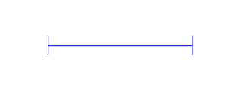













Info Table - Fittings and Fixtures
Symbol | Legend | Description | Power Rating
 | LT | Tube Light | 40 W
 | LW | Wall Mounted Light at Lintel Level | 15 W
 | LC | Ceiling Light | 5 W
 | SS/ESB | Switch Board/ Emergency Switch Board | -
 | SDB | Sub Distribution Board | -
 | ESDB | Emergency Sub Distribution Board | -
 | MDB | Main Distribution Board | -
Symbol | Legend | Description | Power Rating
 | SS | 2 Pin Socket at Switchboard Level (5A) | 100 W
 | TV | Television Socket | 150 W
 | Q | 3 Pin Socket (5A/20A) | 4000 W
 | ST | 2 Pin Socket at Skirting Height (5A) | 100 W
 | EMDB | Emergency Main Distribution Board | -
 | F | Ceiling Fan | 100 W
 | E | Exhaust Fan | 40 W

Slide 10
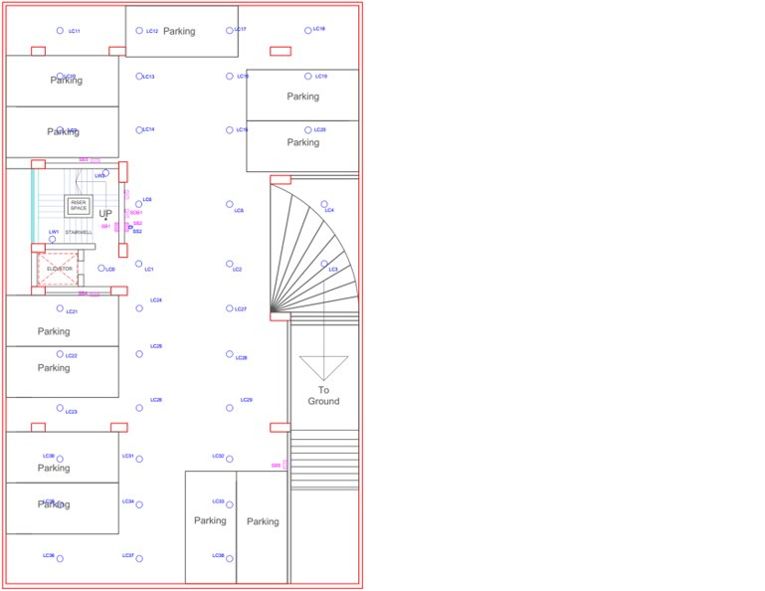
Fittings and Fixtures Basement

Slide 11
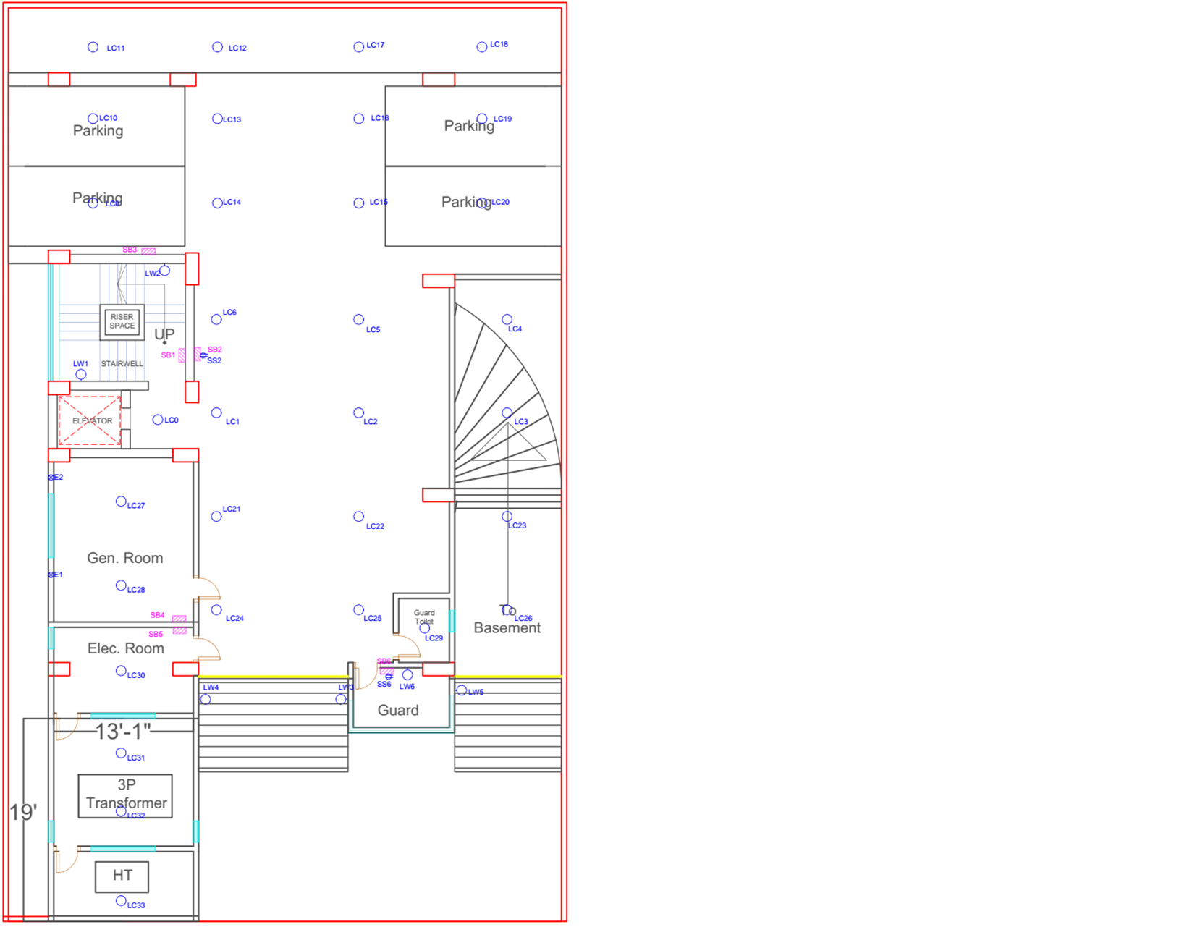
Fittings and Fixtures Ground

Slide 12
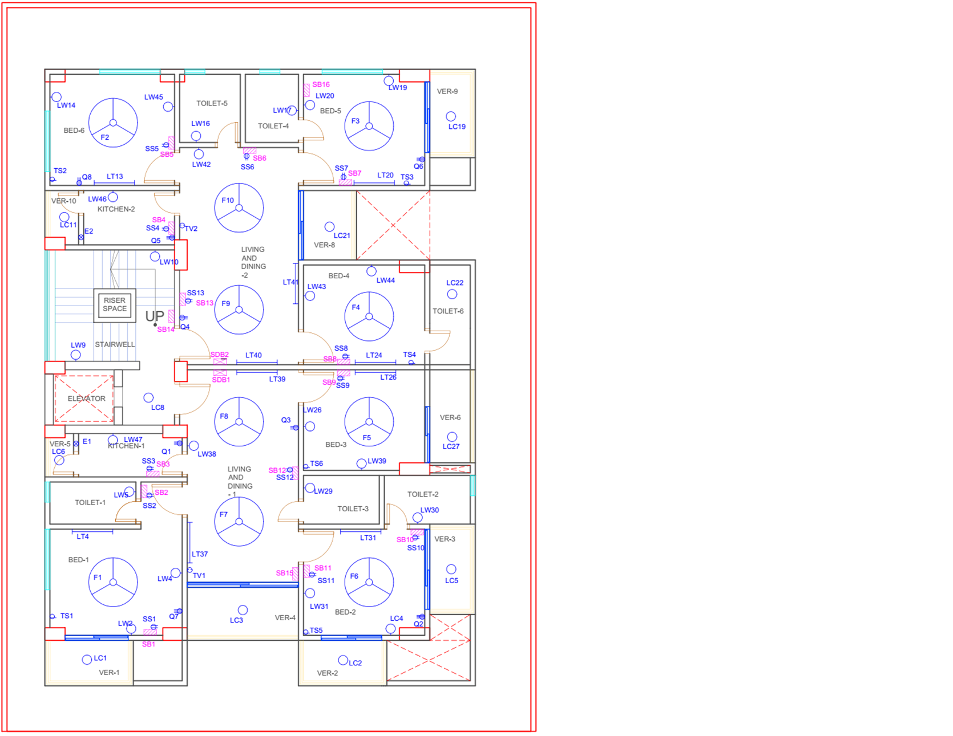
Fittings and Fixtures Typical 2 Unit

Slide 13
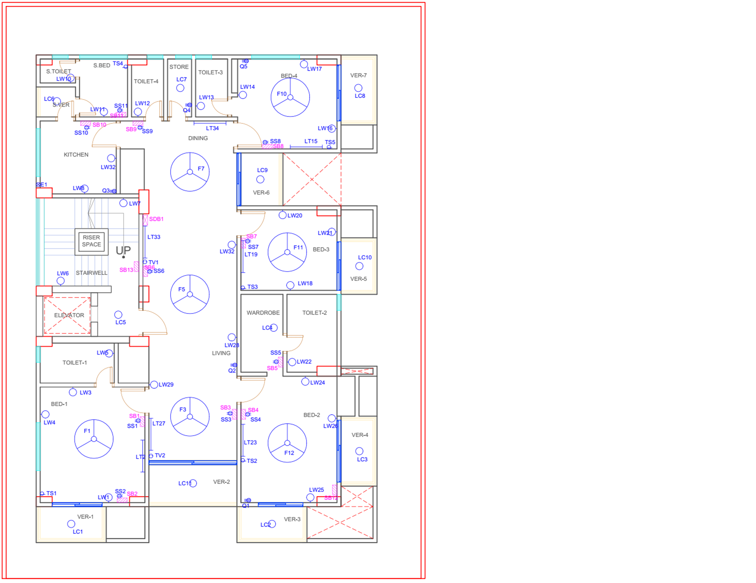
Fittings and Fixtures Typical 1 Unit

Slide 14
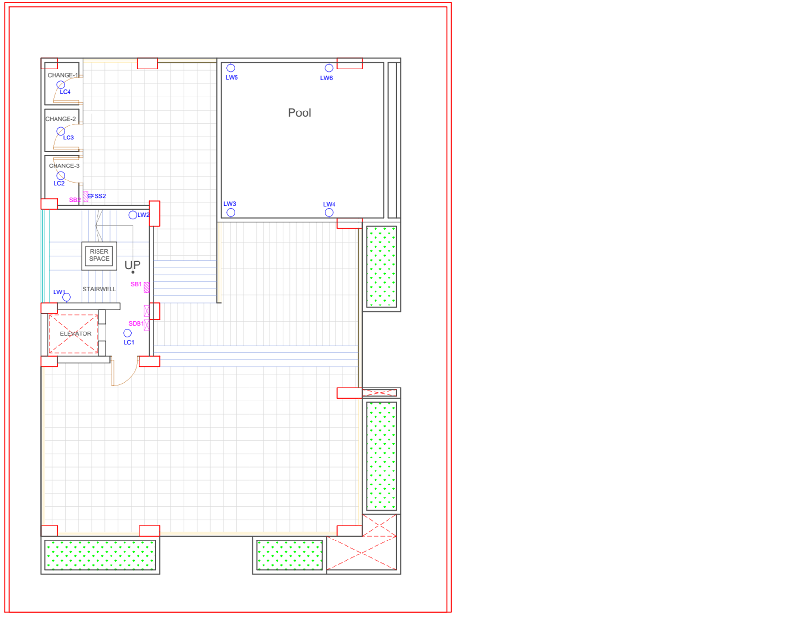
Fittings and Fixtures Roof

Slide 15
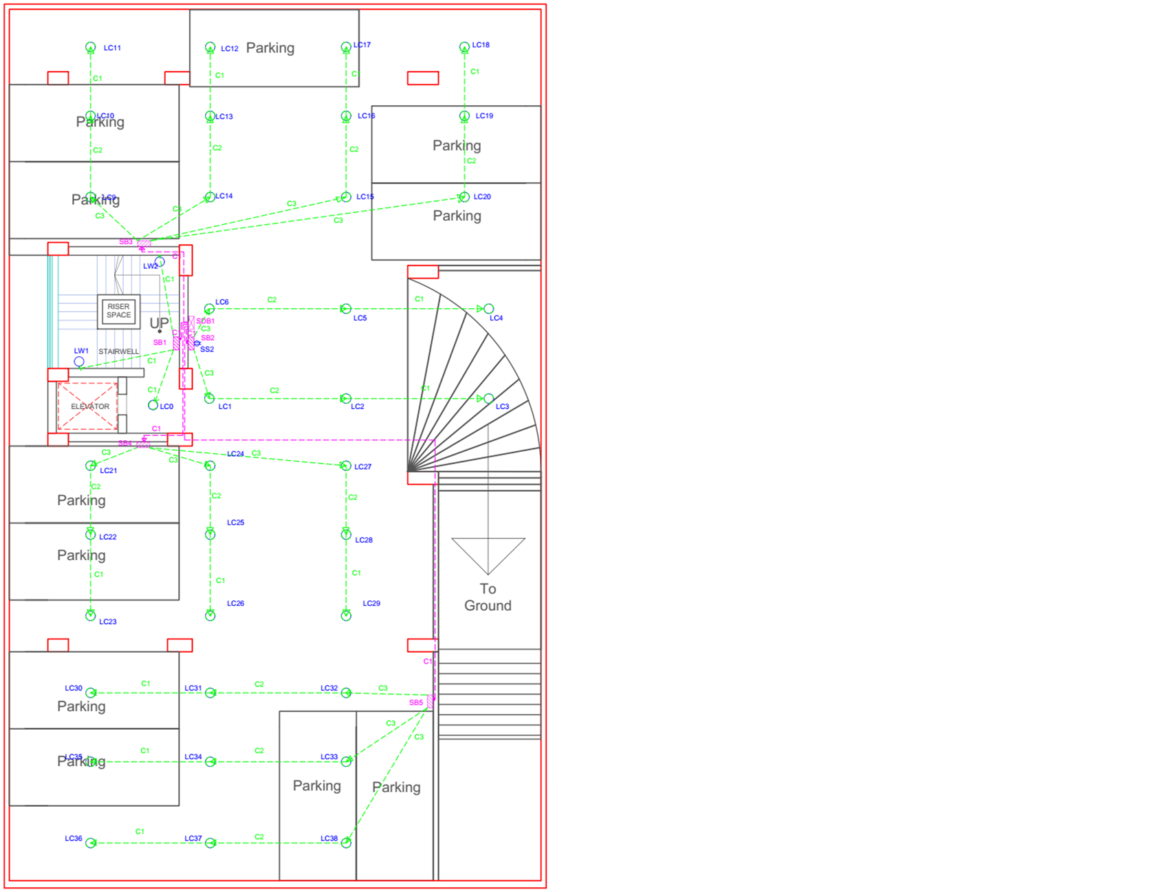
Conduit Layout
Basement

Slide 16
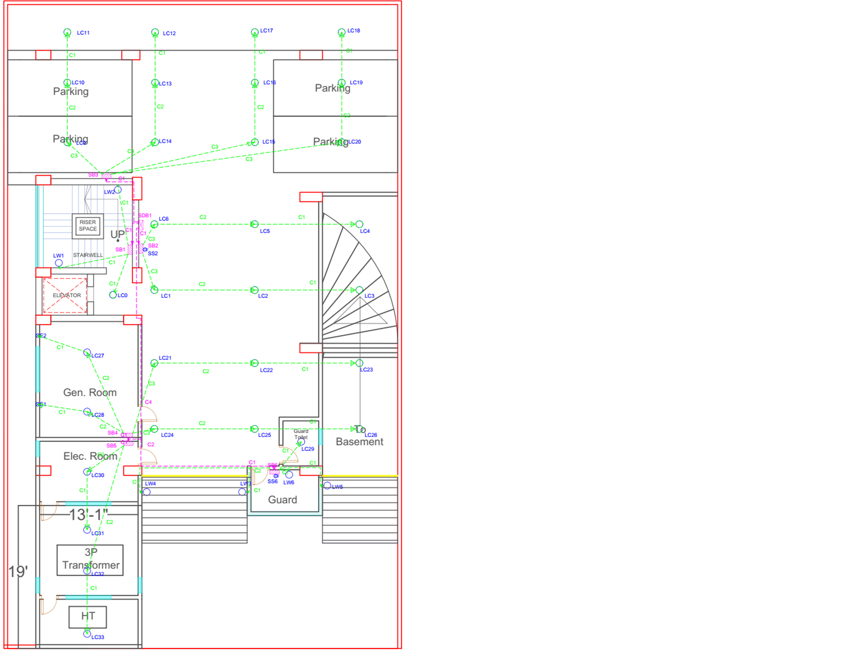
Conduit Layout
Ground

Slide 17
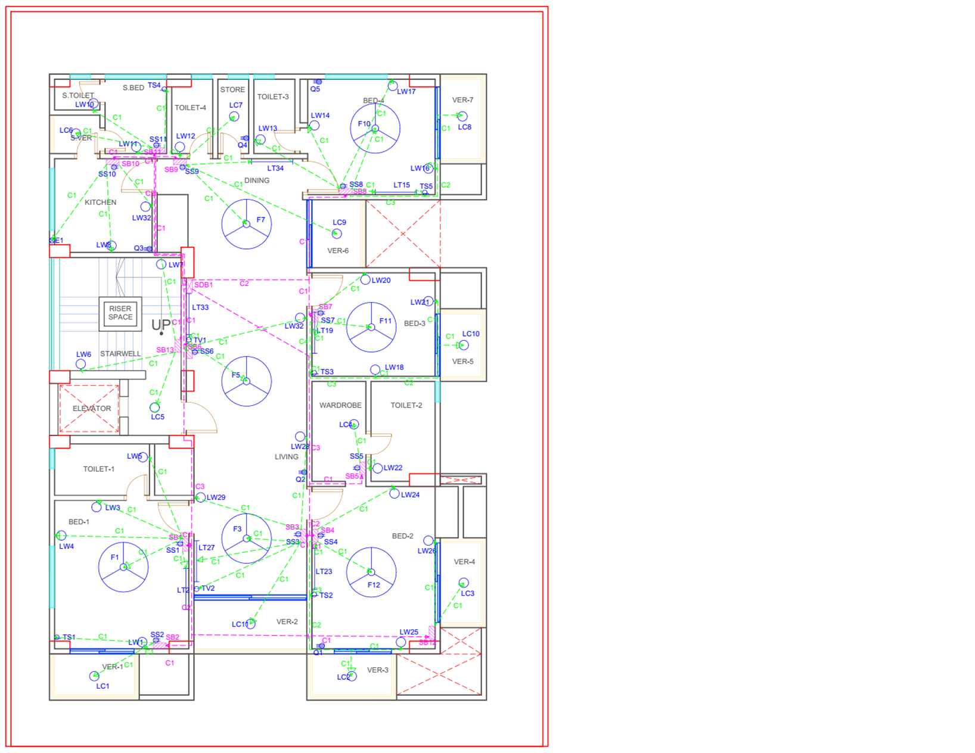
Conduit Layout
Typical 1 Unit

Slide 18
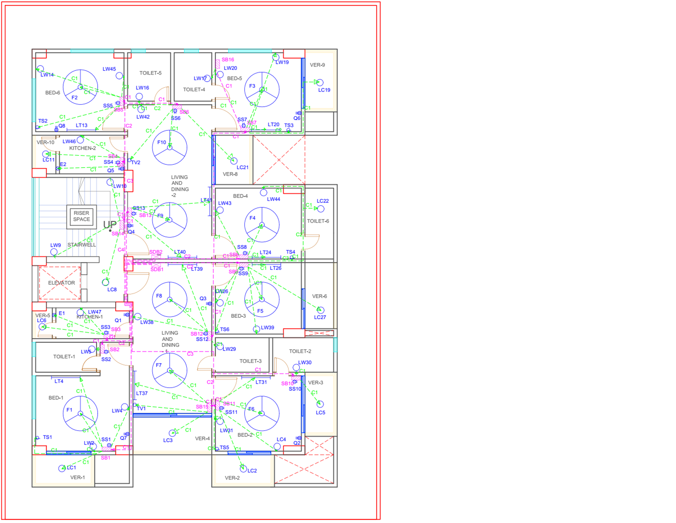
Conduit Layout
Typical 2 Unit

Slide 19
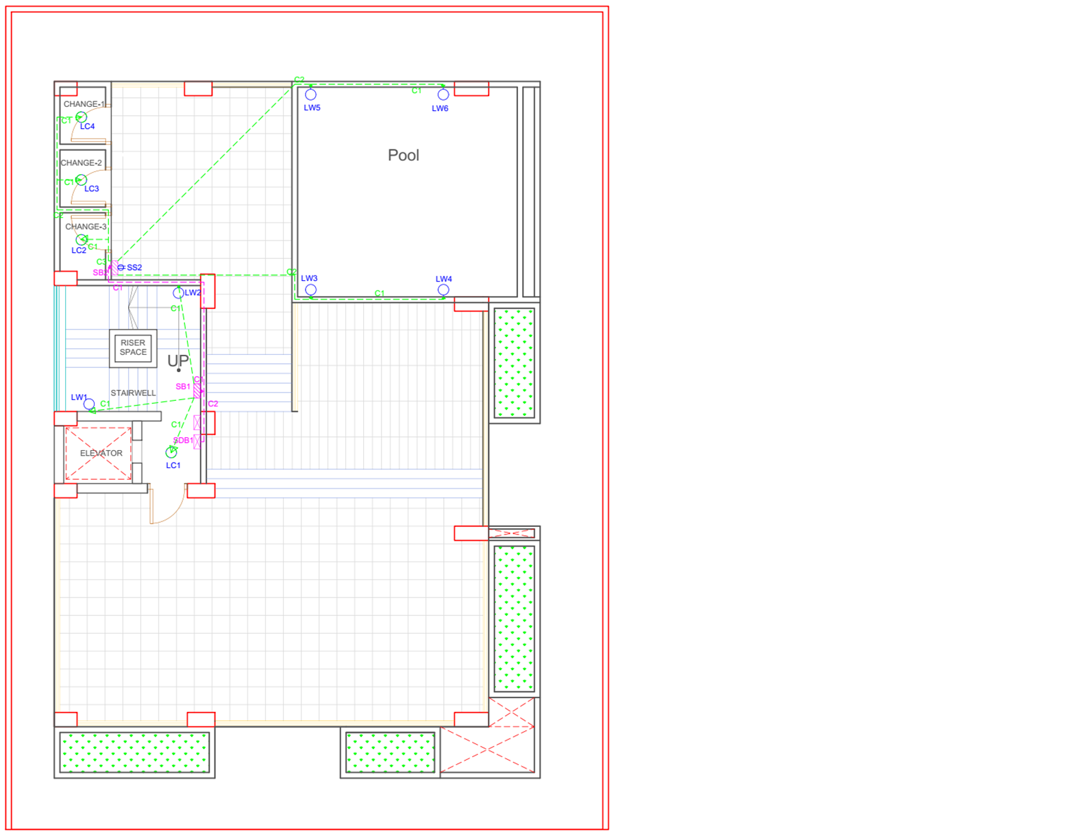
Conduit Layout
Roof

Slide 20
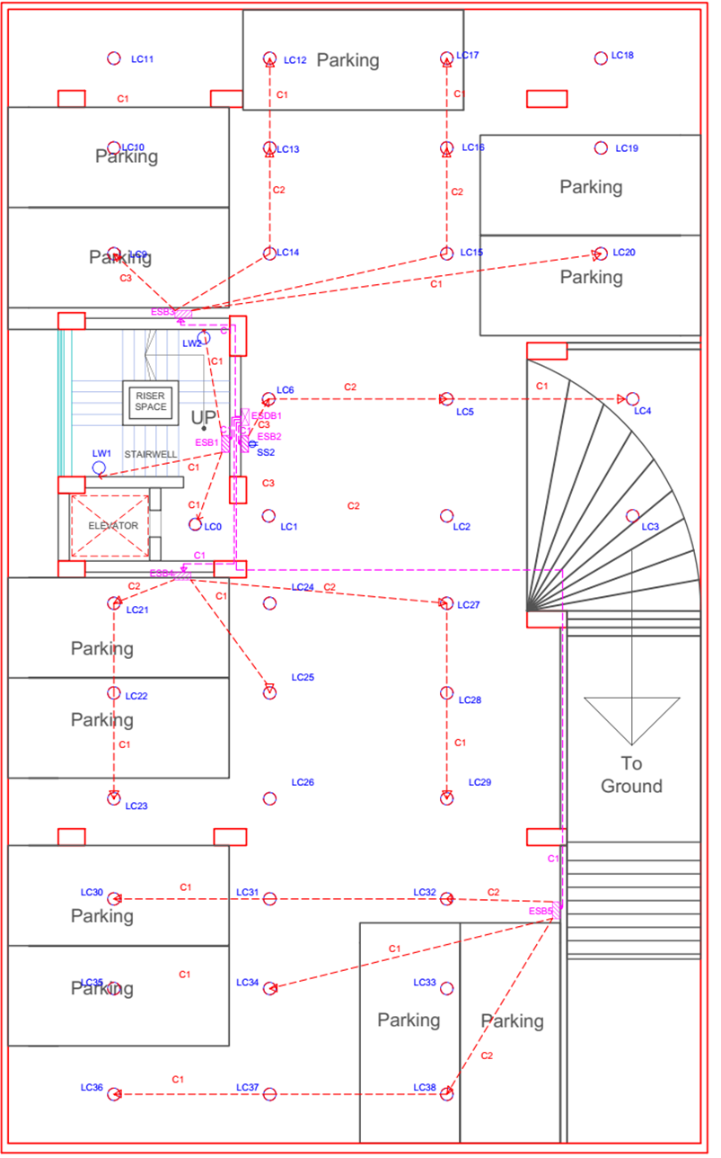
Emergency Conduit Layout
Basement

Slide 21
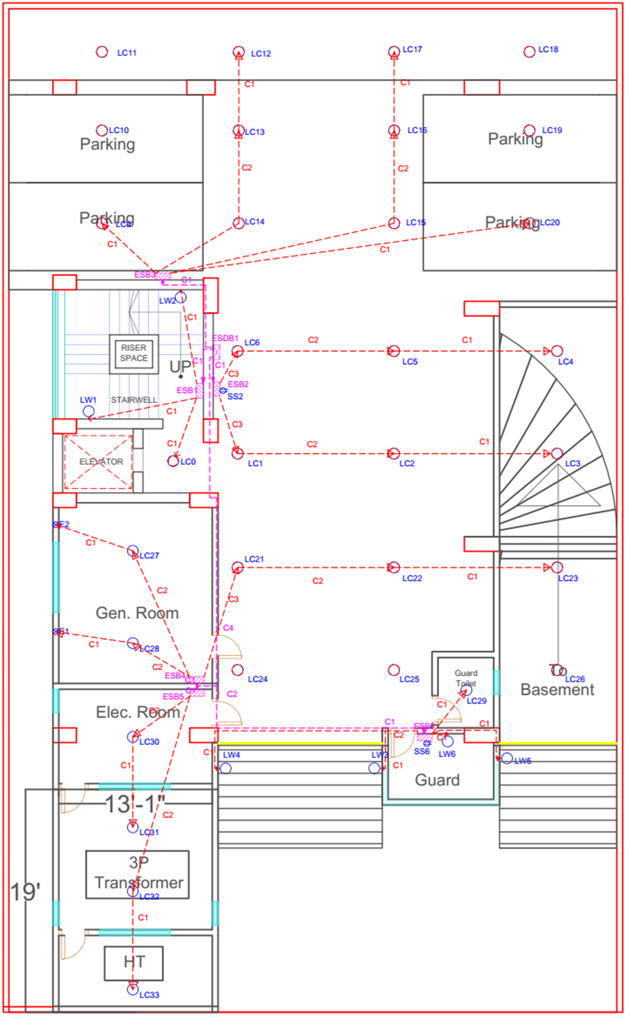
Emergency Conduit Layout
Ground

Slide 22
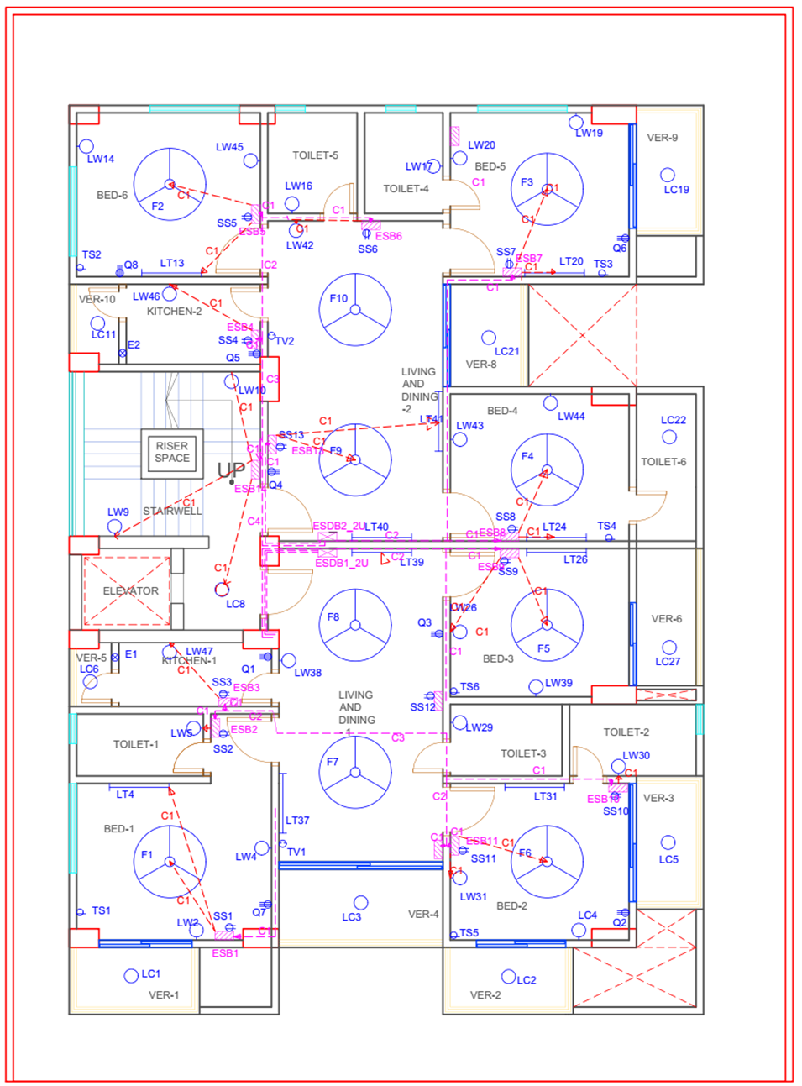
Emergency Conduit Layout
Typical 2 Floor

Slide 23
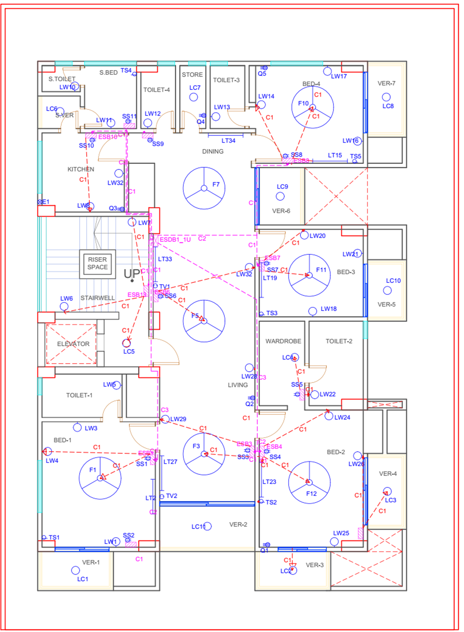
Emergency Conduit Layout
Typical 1 Floor

Slide 24
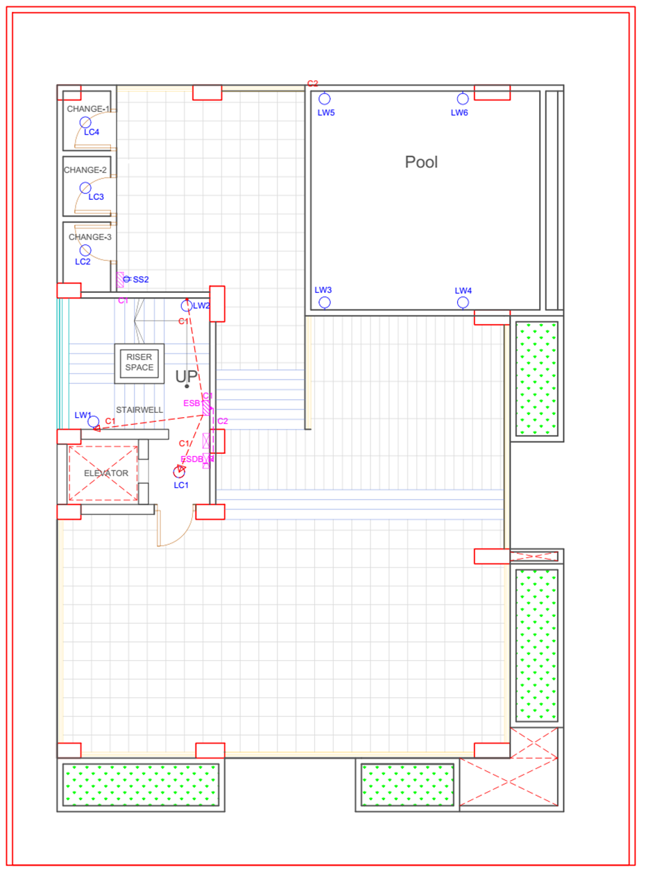
Emergency Conduit Layout
Roof

Slide 25
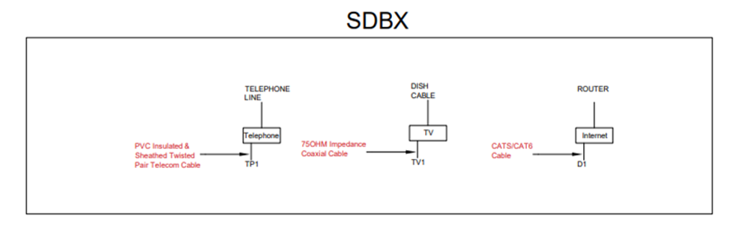
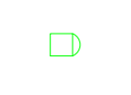


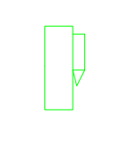
Conduit Layout of TV, Cable and Data Networks
Symbols | Descriptions
 | TV Dish Line
 | Telephone Line
 | Port For Communication
 | Internet Router

Slide 26
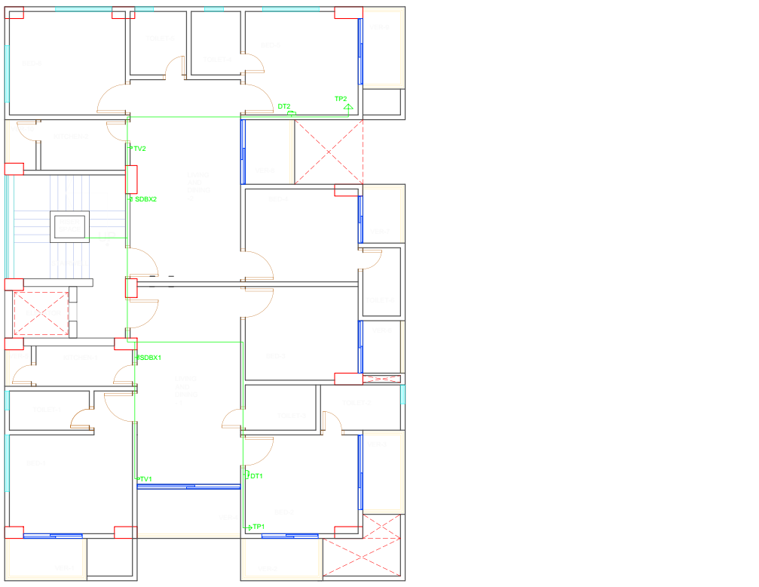
Conduit Layout of
TV, Cable and
Data Networks
2 Unit

Slide 27
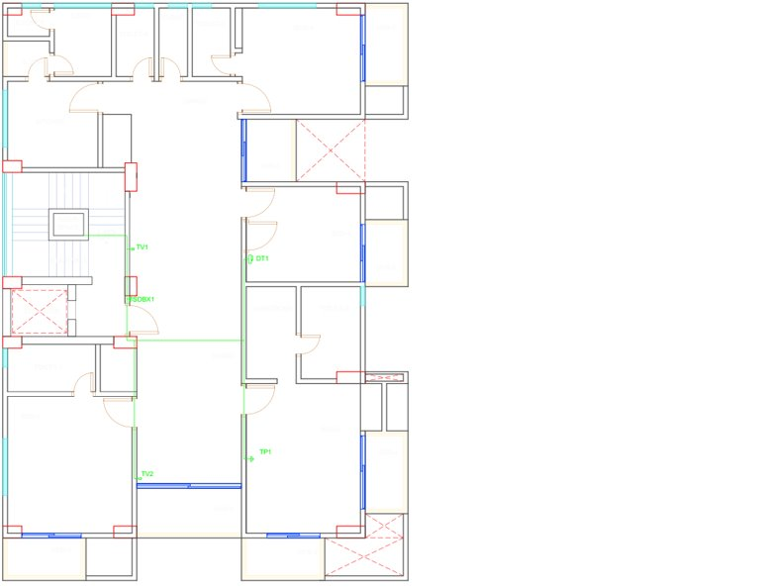
Conduit Layout of
TV, Cable and
Data Networks
1 Unit

Slide 28
Length of the Building: 72'
Width of the Building: 53'
Total Area = 3816 sq ft, 354.6 sq meters
Conductors on the Roof: (24" conductors, 25' maximum gap)
4 on 4 corners
Along the length 2 more conductors are needed
Gap between each conductor = 24'
Along the width 2 more conductors are needed
Gap between each conductor = 17.67'
Down Conductor:
Perimeter of the Building = 250'
Required Down Conductor = 250/100 = 2.5 ~= 3
Lighting Protection System
Calculation

Slide 29
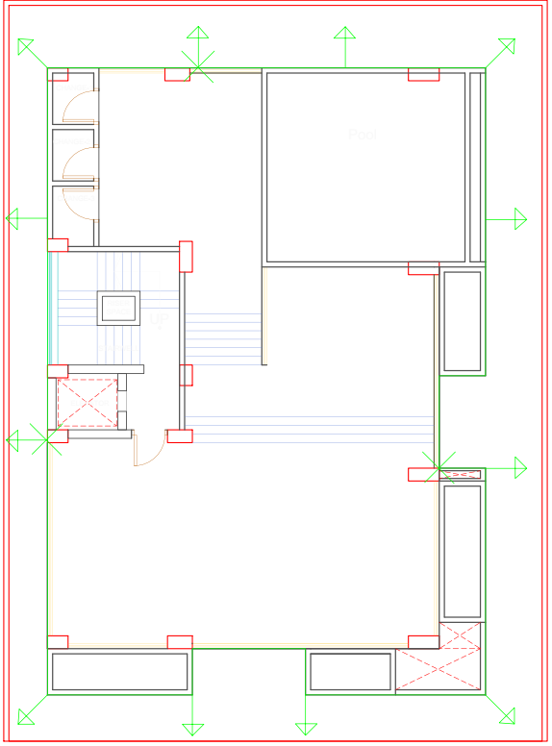

Lighting Protection System
Layout
Roof Conductor
Air Spike
Down Conductor

Slide 30
Some Notes on Fitting and Fixtures and Conduits
We chose 20W LED bulbs and tubelights (2000 W in standard 100 lumen/W rate).
For power socket, 3 pin Q (20A, 4000W) were used. We tried to distribute 4 power sockets to each of the dual units and 5 to the single unit.
For emergency conduit, only one light and one fan per each bedroom, half of the lights in the garage, the stair lights and some few other lights were kept. Our emergency system is part of the main system and works as a partial backup, so we didn’t add any separate emergency system.

Slide 31
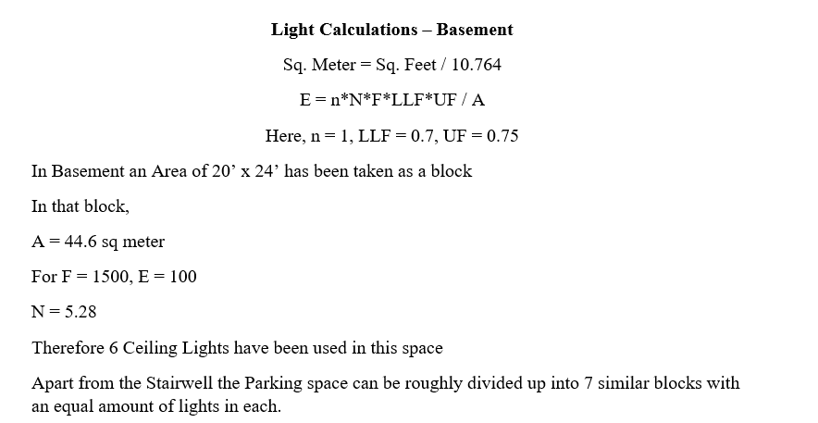

Slide 32
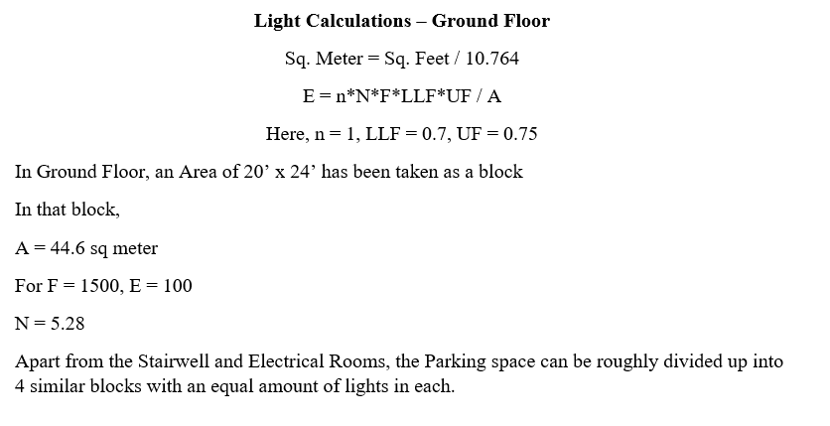

Slide 33
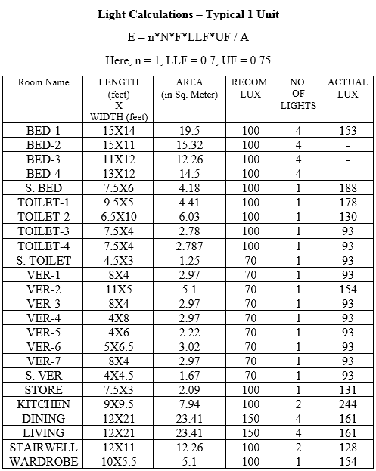
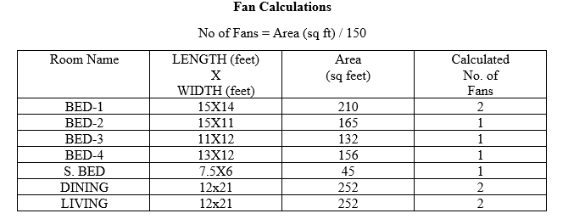

Slide 34
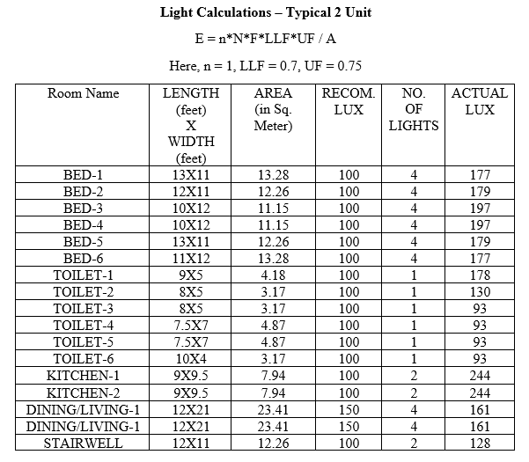
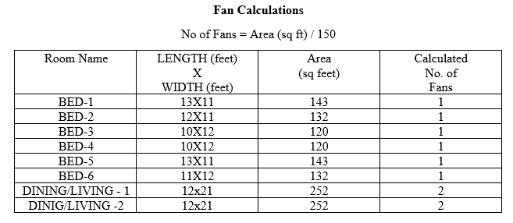

Slide 35
Switch Board Diagrams

Slide 36
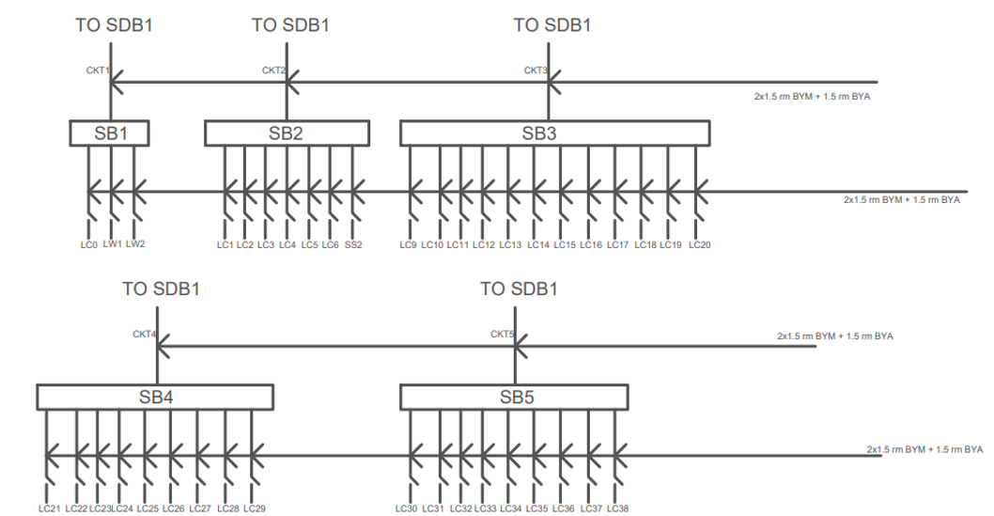
Switch Board Connection Diagram – Basement

Slide 37
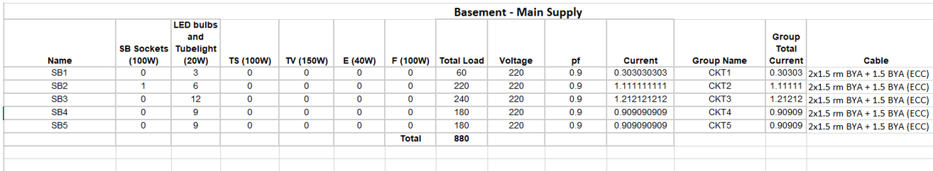
Switch Board Connection Calculations – Basement

Slide 38
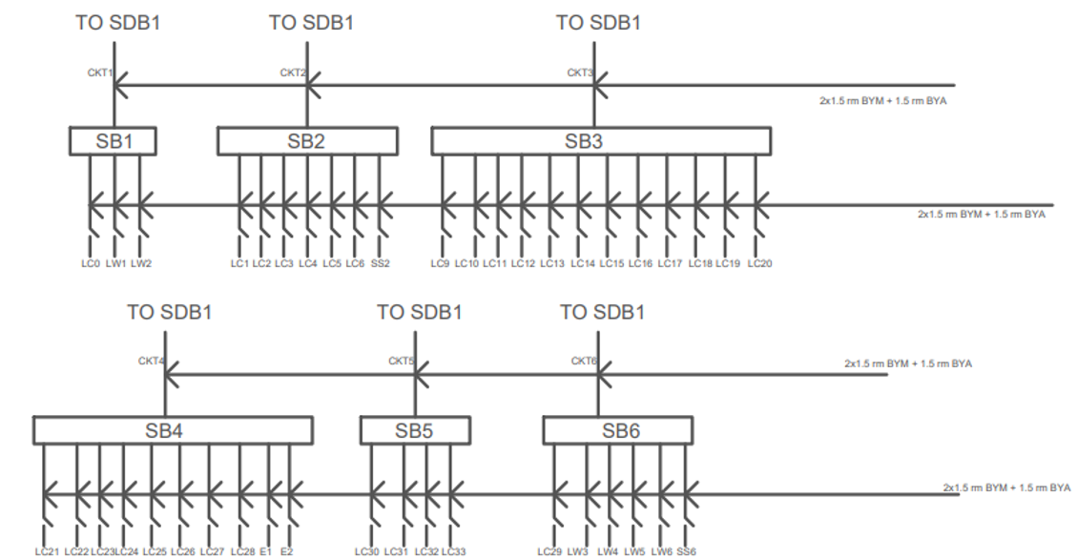
Switch Board Connection Diagram – Ground Floor

Slide 39
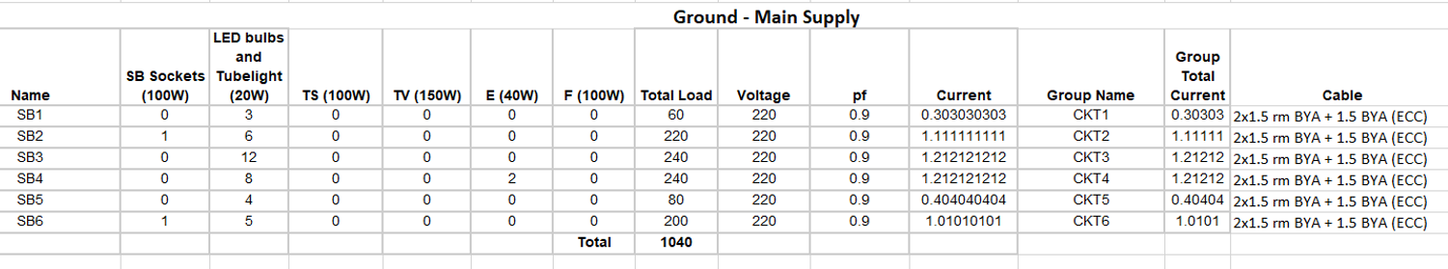
Switch Board Connection Calculations – Ground Floor

Slide 40
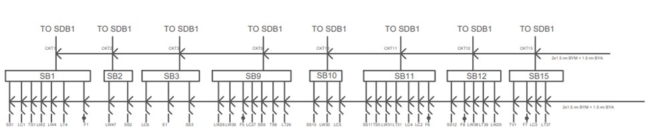
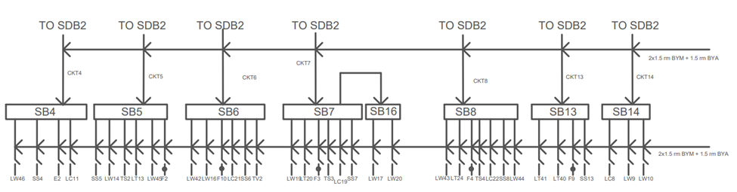
Switch Board Connection Diagram – Typical 2 Unit

Slide 41
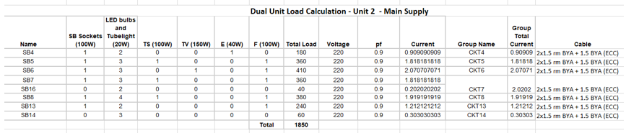
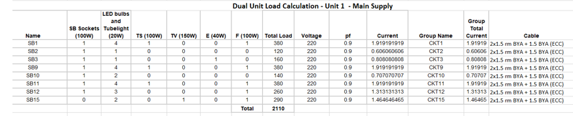
Switch Board Connection Calculation – Typical 2 Unit

Slide 42
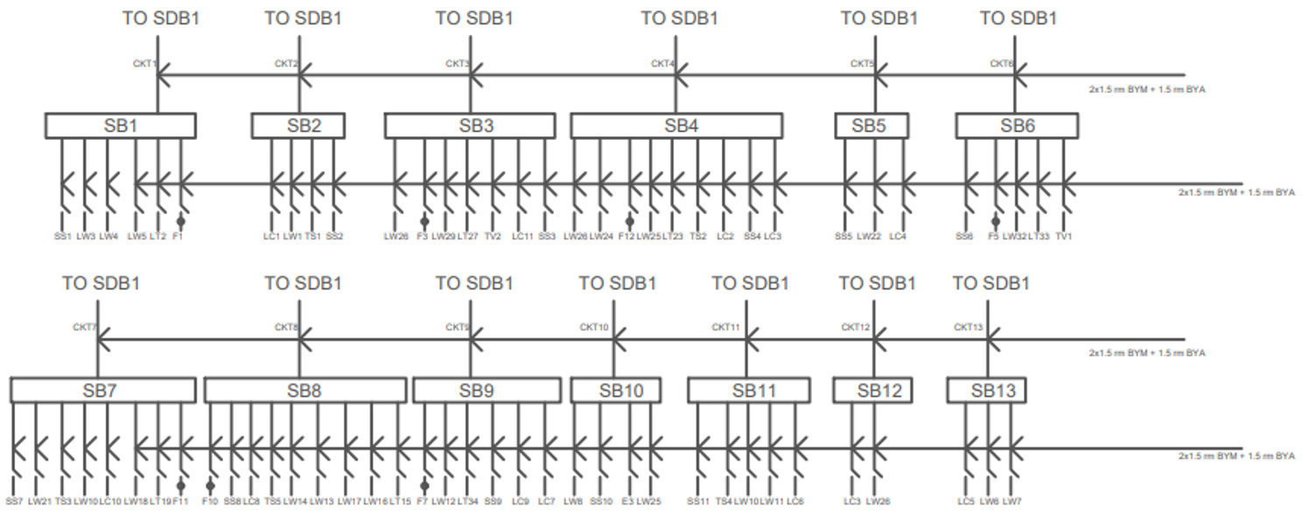
Switch Board Connection Diagram – Typical 1 Unit

Slide 43
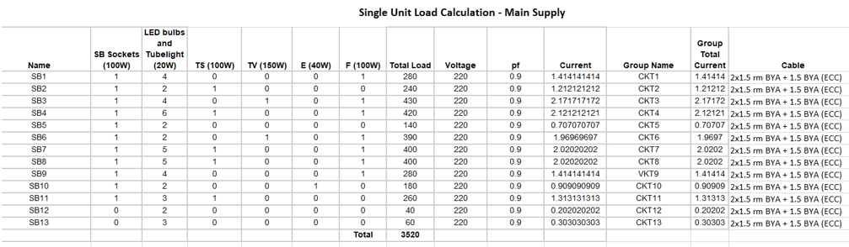
Switch Board Connection Calculation – Typical 1 Unit

Slide 44
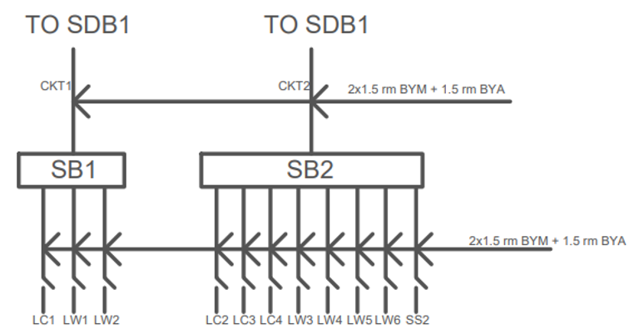
Switch Board Connection Diagram – Roof

Slide 45
Switch Board Connection Calculations – Roof

Slide 46
Emergency Switch Board Diagrams

Slide 47
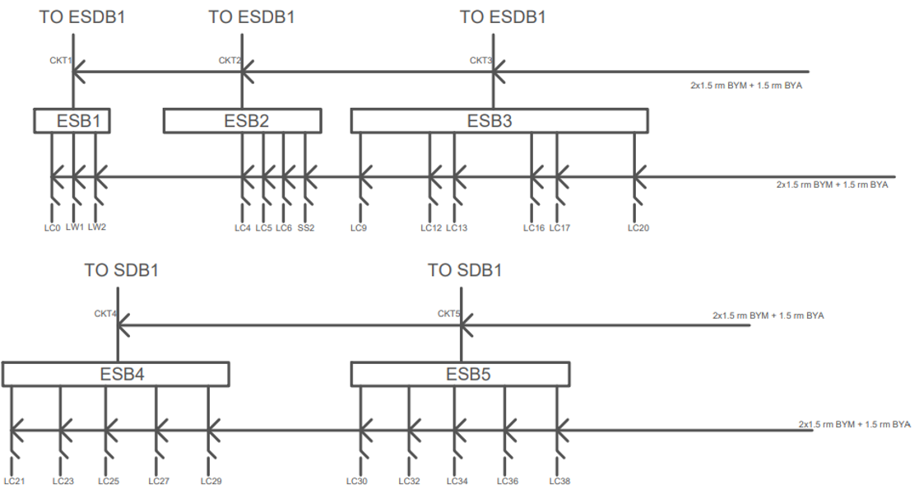
Emergency Switch Board Connection Diagram – Basement

Slide 48
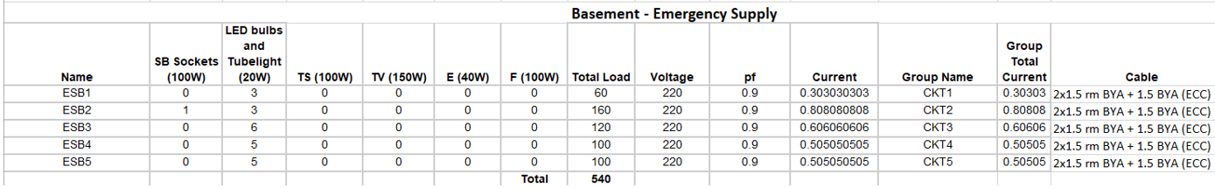
Emergency Switch Board Connection Calculations – Basement

Slide 49
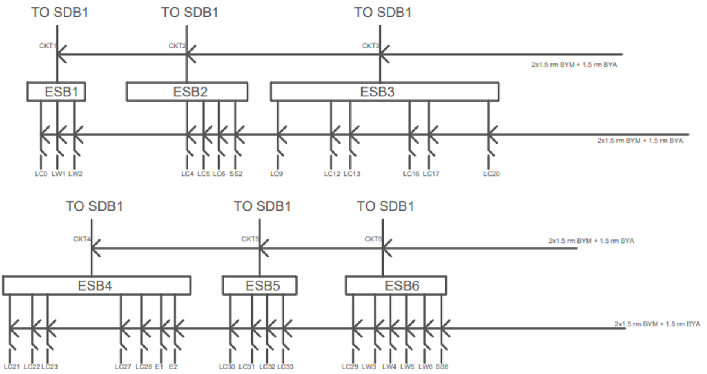
Emergency Switch Board Connection Diagram – Ground Floor

Slide 50
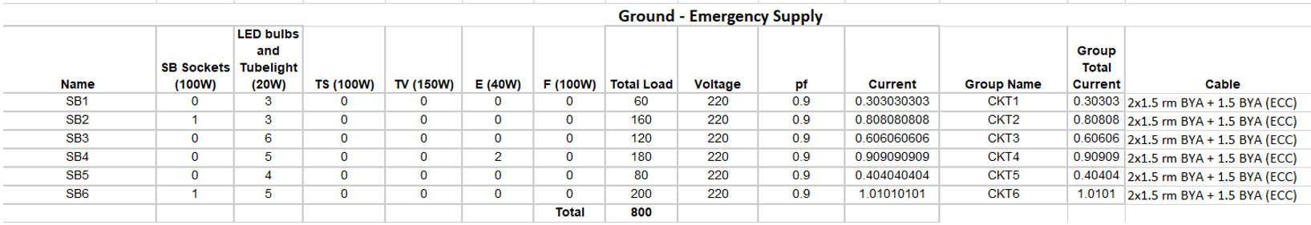
Emergency Switch Board Connection Calculations – Ground Floor

Slide 51
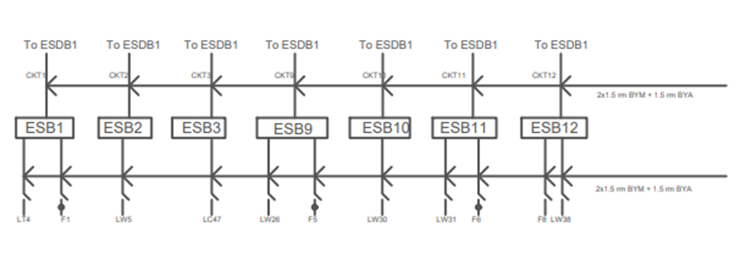

Emergency Switch Board Connection Diagram – Typical 2 Unit

Slide 52


Emergency Switch Board Connection Diagram – Typical 2 Unit (Unit 1)

Slide 53

Emergency Switch Board Connection Diagram – Typical 1 Unit

Slide 54

Emergency Switch Board Connection Diagram – Typical 1 Unit

Slide 55

Emergency Switch Board Connection Diagram – Roof

Slide 56
Emergency Switch Board Connection Calculations – Roof

Slide 57
Sub Distribution Board Diagrams

Slide 58

SDB Diagram – Basement

Slide 59
SDB Calculations - Basement
Calculation:
For SDB_U, we notice that all switchboards are below 5A rating (similarly for the emergency case, as load is even lesser). Thus, standard 2 x 1.5 rm BYM cables and 1.5 BYA ECC cable has been used for connecting switchboards to SDBs, along with 5A MCB breakers.
We assume utility factor for normal load to be 0.7, assuming they would be operating 70% of the time. Power Factor = 0.9
SDB_U:
Load = 0.7 x total load = 0.7 x 880 = 616W (No power sockets are present here) Current = 616/(220 x 0.9) = 3.11 A Thus, 2 x 1.5 rm BYM cables and 1.5 BYA ECC cable has been used, along with 5A MCCB breaker, to connect it to the MDB.

Slide 60

SDB Diagram – Ground Floor

Slide 61
SDB Calculations – Ground Floor
Calculation:
For SDB_G, we notice that all switchboards are below 5A rating (similarly for the emergency case, as load is even lesser). Thus, standard 2 x 1.5 rm BYM cables and 1.5 BYA ECC cable has been used for connecting switchboards to SDBs, along with 5A MCB breakers.
We assume utility factor for normal load to be 0.7, assuming they would be operating 70% of the time. Power Factor = 0.9
SDB_G:
Load = 0.7 x total load = 0.7 x 1040 = 728W (No power sockets are present here) Current = 728/(220 x 0.9) = 3.677 A Thus, 2 x 1.5 rm BYM cables and 1.5 BYA ECC cable has been used, along with 5A SP MCCB breaker, to connect it to the MDB.

Slide 62

SDB Diagram – Single Unit

Slide 63
SDB Calculation – Single Unit
For SDB_U1, we notice that all switchboards are below 5A rating (similarly for the emergency case, as load is even lesser). Thus, standard 2 x 1.5 rm BYM cables and 1.5 BYA ECC cable has been used for connecting switchboards to SDBs, along with 5A MCB breakers.
Here, power sockets with rating 20A and 4000W are present. (4000V/220A = 18.18A). Thus, we have used 20A SP MCB Breakers and 2x6 rm BYM + 6 rm BYA ECC wires.
We assume utility factor for normal load to be 0.7, assuming they would be operating 70% of the time.
For a typical AC, watt rating is 1500 Watt. As our power socket is 4000W, the ratio is then 1500/4000 = 0.375. But an AC will not run all the time. If we assume it runs 80% of the time during summer, then our utility factor should be 0.8x0.375 = 0.3. Thus for power sockets, we assume utility factor to be 30%.
Here, power factor = 0.9
SDB_U1:
Load = 0.7 x total load + 0.4 x power socket load = 0.7 x 3520 + 0.3 x 4000 x 5 = 8464W (5 Q sockets are present) Current = 8464/(220 x 0.9) = 42.75 A Thus, 2 x 25 rm BYM cables and 25 rm BYA ECC cable has been used, along with 50A SP MCCB breaker, to connect it to the MDB.

Slide 64

SDB Diagram – Double Unit – Unit 1

Slide 65
SDB Calculation – Double Unit – Unit 1
Calculation:
For SDB1_U2, we notice that all switchboards are below 5A rating (similarly for the emergency case, as load is even lesser). Thus, standard 2 x 1.5 rm BYM cables and 1.5 BYA ECC cable has been used for connecting switchboards to SDBs, along with 5A MCB breakers.
Here, power sockets with rating 20A and 4000W are present. (4000V/220A = 18.18A). Thus, we have used 20A SP MCB Breakers and 2x6 rm BYM + 6 rm BYA ECC wires.
We assume utility factor for normal load to be 0.7, assuming they would be operating 70% of the time. And for power sockets, we assume utility factor to be 30%.
Here, power factor = 0.9
SDB1_U2:
Load = 0.7 x total load + 0.9 x power socket load = 0.7 x 2110 + 0.3 x 4000 x 4 = 6277W (4 Q sockets are present) Current = 6277/(220 x 0.9) = 31.7 A Thus, 2 x 16 rm BYM cables and 16 rm BYA ECC cable has been used, along with 40A SP MCCB breaker, to connect it to the MDB.

Slide 66

SDB Diagram – Double Unit – Unit 2

Slide 67
SDB Calculation – Double Unit – Unit 2
Calculation:
For SDB2_U2, we notice that all switchboards are below 5A rating (similarly for the emergency case, as load is even lesser). Thus, standard 2 x 1.5 rm BYM cables and 1.5 BYA ECC cable has been used for connecting switchboards to SDBs, along with 5A MCB breakers.
Here, power sockets with rating 20A and 4000W are present. (4000V/220A = 18.18A). Thus, we have used 20A SP MCB Breakers and 2x6 rm BYM + 6 rm BYA ECC wires.
We assume utility factor for normal load to be 0.7, assuming they would be operating 70% of the time. And for power sockets, we assume utility factor to be 40%.
Here, power factor = 0.9
SDB2_U2:
Load = 0.7 x total load + 0.9 x power socket load = 0.7 x 1850 + 0.4 x 4000 x 4 = 6095W (4 Q sockets are present) Current = 7695/(220 x 0.9) = 30.78 A Thus, 2 x 16 rm BYM cables and 16 rm BYA ECC cable has been used, along with 40A SP MCCB breaker, to connect it to the MDB.

Slide 68

SDB Diagram – Roof

Slide 69
SDB Calculation – Roof
Calculation:
For SDB_R, we notice that all switchboards are below 5A rating (similarly for the emergency case, as load is even lesser). Thus, standard 2 x 1.5 rm BYM cables and 1.5 BYA ECC cable has been used for connecting switchboards to SDBs, along with 5A MCB breakers.
We assume utility factor for normal load to be 0.7, assuming they would be operating 70% of the time. Power Factor = 0.9
SDB_R:
Load = 0.7 x total load = 0.7 x 250 = 175W (No power sockets are present here) Current = 175/(220 x 0.9) = 0.88 A Thus, 2 x 1.5 rm BYM cables and 1.5 BYA ECC cable has been used, along with 5A SP MCCB breaker, to connect it to the MDB.

Slide 70
Emergency Sub Distribution Board Diagrams

Slide 71

ESDB Diagram – Basement

Slide 72
ESDB Calculations - Basement
ESDB_U:
Emergency Load = 0.7 x total emergency load = 0.7 x 540 = 378W Current = 616/(220 x 0.9) = 1.9 A Thus, 2 x 1.5 rm BYM cables and 1.5 BYA ECC cable has been used, along with 5A MCCB breaker, to connect it to the EMDB.

Slide 73

ESDB Diagram – Ground Floor

Slide 74
ESDB Calculations – Ground Floor
ESDB_U:
Load = 0.7 x total emergency load = 0.7 x 800 = 560W Current = 560/(220 x 0.9) = 2.83 A Thus, 2 x 1.5 rm BYM cables and 1.5 BYA ECC cable has been used, along with 5A SP MCCB breaker, to connect it to the EMDB.

Slide 75

ESDB Diagram – Single Unit

Slide 76
ESDB Calculations – Single Unit
ESDB_U1:
For emergency condition, we will assume the power socket utility factor to be 0.2
Load = 0.7 x total emergency load + 0.2 x power socket load = 0.7 x 800 + 0.2 x 4000 = 1360W (1 Q socket is present on emergency) Current = 1360/(220 x 0.9) = 6.87 A Thus, 2 x 2.5 rm BYM cables and 2.5 rm BYA ECC cable has been used, along with 10A SP MCCB breaker, to connect it to the EMDB.

Slide 77

ESDB Diagram – Double Unit – Unit 1

Slide 78
ESDB Calculations – Double Unit – Unit 1
ESDB1_U2:
For emergency condition, we will assume the power socket utility factor to be 0.2
Load = 0.7 x total emergency load + 0.2 x power socket load = 0.7 x 540 + 0.2 x 4000 = 1178W (1 Q socket is present on emergency) Current = 1360/(220 x 0.9) = 5.95 A Thus, 2 x 2.5 rm BYM cables and 2.5 rm BYA ECC cable has been used, along with 10A SP MCCB breaker, to connect it to the EMDB.

Slide 79


ESDB Diagram – Double Unit – Unit 2

Slide 80
ESDB Calculations – Double Unit – Unit 1
ESDB2_U2:
For emergency condition, we will assume the power socket utility factor to be 0.2
Load = 0.7 x total emergency load + 0.2 x power socket load = 0.7 x 560 + 0.2 x 4000 = 1192W (1 Q socket is present on emergency) Current = 1192/(220 x 0.9) = 6.02 A Thus, 2 x 2.5 rm BYM cables and 2.5 rm BYA ECC cable has been used, along with 10A SP MCCB breaker, to connect it to the EMDB.

Slide 81

ESDB Diagram – Roof

Slide 82
ESDB Calculations – Roof
ESDB_R:
Load = 0.7 x total emergency load = 0.7 x 45 = 31.5W Current = 31.5/(220 x 0.9) = 0.159 A Thus, 2 x 1.5 rm BYM cables and 1.5 BYA ECC cable has been used, along with 5A SP MCCB breaker, to connect it to the EMDB.

Slide 83
MDB and EMDB Diagrams

Slide 84

Main Distribution Board Connection Diagram
40 kVA Generator

Slide 85
MDB Calculations
The SDB loads are listed below: SDB_U = 616 W SDB_G = 728 W SDB1_1U = 8464 SDB1_2U = 6277 SDB2_2U = 6095 SDB_R = 175
Keeping in mind that 6 floors are dual units and 3 are single units, and we have installed extra Lift (18500 W) and pump (5000W), and utility factor = 0.7
Thus,
total MDB load = (SDB_U + SDB_G + SDB_R + 3x(SDB1_1U) + 6x(SDB1_2U + SDB2_2U) + Pump + Lift) x Utility Factor = 87.250 kW
As our Emergency system is not separate from the system supplied by the main, we don’t include EMDB loads in our MDB calculation, as it is already included.
Now,
I = P/3*V*PF = 146.89 A (V=220 V, pf = 0.9)
Thus, we will need 2x120 rm NYY + 120 rm BYA ECC wire and a 150 A SP MCCB Breaker.
S = P/pf = 96.944 kVA
We will need a 100kVA transformer substation.

Slide 86
Others
PFI Plant
Here, Q = Ptan(cos⁻¹(pf)) = 87.250 tan(cos⁻¹(0.9)) = 42.257 KVAR
The PFI plant needs to deliver this much capacitive reactive power to bring the power factor close to unity.
Thus, current = Q/3*V*sin(cos⁻¹(pf)) = 146.88 A
We need to use 2x120 rm NYY + 120 BYA ECC wires along with 150A SP MCCB breakers.
Elevator
Power = 18500 W Let, pf = 0.7 Thus, current = 18500 / 3*220*0.7 = 40.0432 A Thus, we need to use 2x25 rm NYY + 25 BYA ECC wires along with 50A SP MCCB breakers.
Pump
Power = 5000 W Let, pf = 0.7 Thus, current = 5000 / 3*220*0.7 = 10.823 A Thus, we need to use 2x4 rm NYY + 4 BYA ECC wires along with 15A SP MCCB breakers.

Slide 87

Emergency Main Distribution Board Connection Diagram

Slide 88
EMDB Calculations
The ESDB loads are listed below:
ESDB_U = 378 W ESDB_G = 560 W ESDB1_1U = 1360 ESDB1_2U = 1178 ESDB2_2U = 1192 ESDB_R = 31.5
total EMDB load = (ESDB_U + ESDB_G + ESDB_R + 3x(ESDB1_1U) + 6x(ESDB1_2U + ESDB2_2U) + Lift) x Utility Factor = 26.438 kW
Current
I = P/3*V*PF = 44.51 A (V=220 V, pf = 0.9)
Thus, we will need 2x25 rm NYY + 25 rm BYA ECC wire and a 50 A SP MCCB Breaker.
Apparent Power
S = P/pf = 29.38 kVA
Thus, a 40 kVA Generator is to be used.

Slide 89

References

Slide 90
Thank You for Your Patience

